Slide 2
Properties of Sound
Sound is
  Pressure disturbance (alternating areas of high and low pressure) produced by vibrating object
Sound wave
  Moves outward in all directions
  Illustrated as an S-shaped curve or sine wave

Slide 3
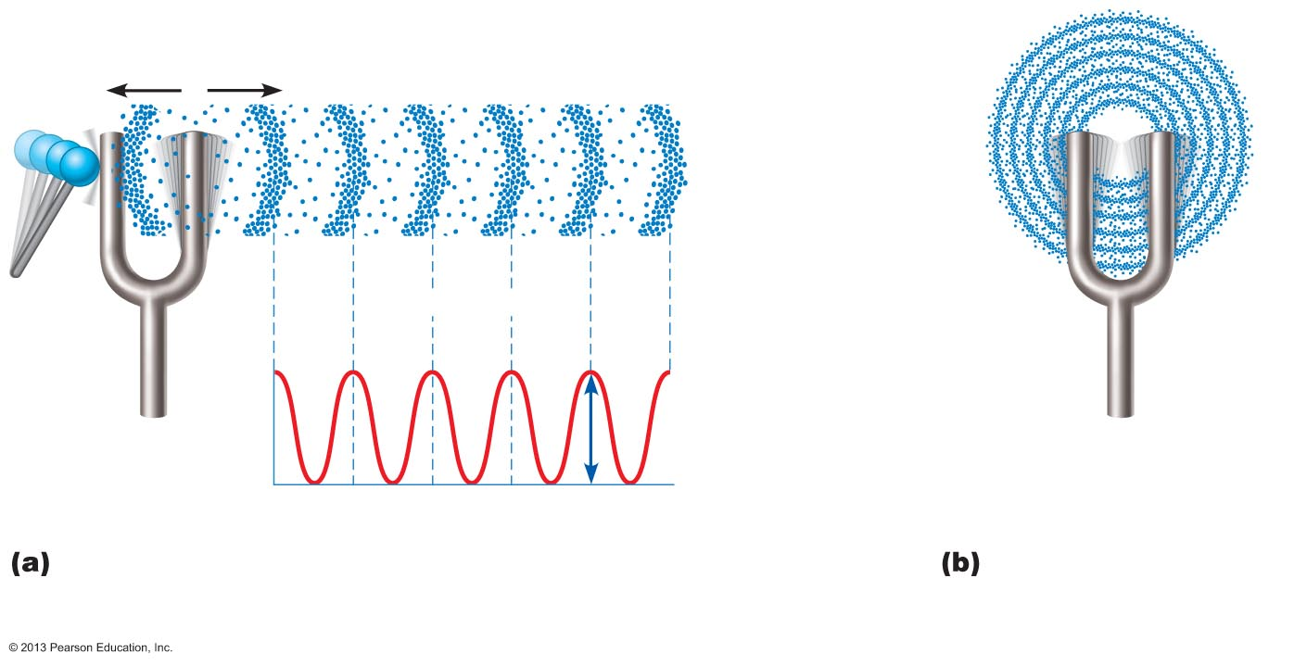
Figure 15.28 Sound: Source and propagation.
Area of
high pressure
(compressed
molecules)
Area of
low pressure
(rarefaction)
Wavelength
Crest
Air pressure
Trough
Distance
Amplitude
A struck tuning fork alternately compresses
and rarefies the air molecules around it, creating
alternate zones of high and low pressure.
Sound waves radiate
outward in all
directions.

Slide 4
Properties of Sound Waves
Frequency
  Number of waves that pass given point in given time
  Pure tone has repeating crests and troughs
  Wavelength
    Distance between two consecutive crests
    Shorter wavelength = higher frequency of sound

Slide 5
Properties of Sound
Pitch
  Perception of different frequencies
  Normal range 20–20,000 hertz (Hz)
  Higher frequency = higher pitch
Quality
  Most sounds mixtures of different frequencies
  Richness and complexity of sounds (music)

Slide 6
Properties of Sound
Amplitude
  Height of crests
Amplitude perceived as loudness
  Subjective interpretation of sound intensity
  Normal range is 0–120 decibels (dB)
  Severe hearing loss with prolonged exposure above 90 dB
    Amplified rock music is 120 dB or more

Slide 7
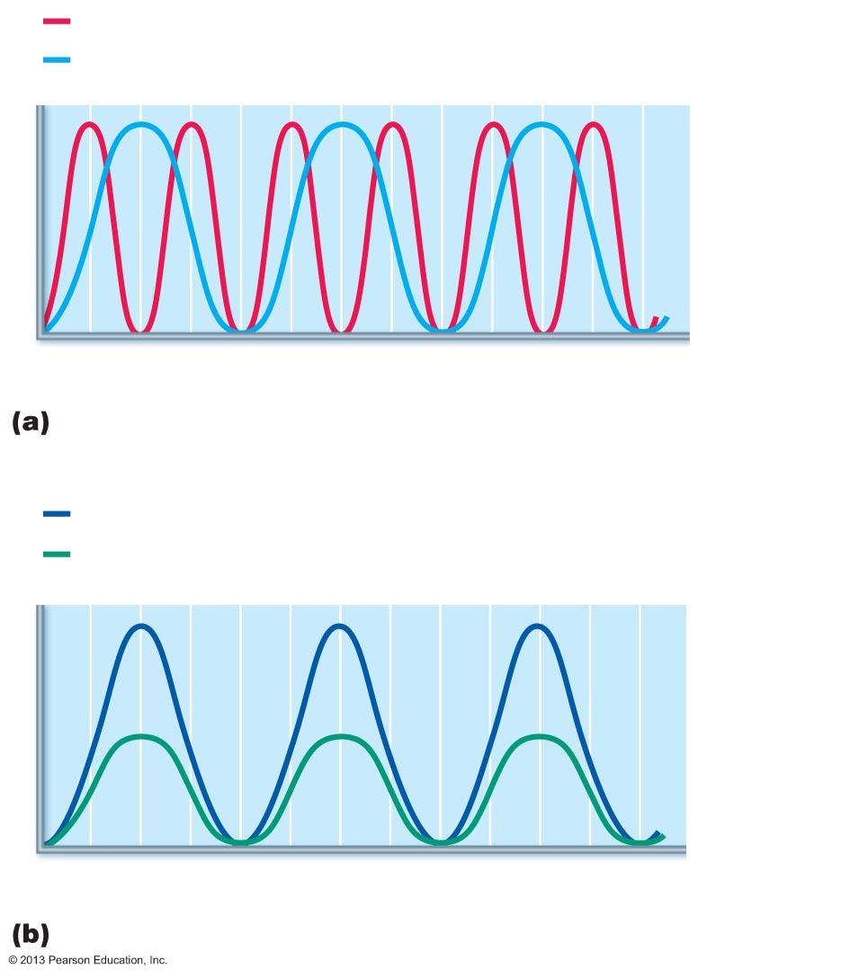
Figure 15.29 Frequency and amplitude of sound waves.
High frequency (short wavelength) = high pitch
Low frequency (long wavelength) = low pitch
Pressure
0.01
0.02
0.03
Time (s)
Frequency is perceived as pitch.
High amplitude = loud
Low amplitude = soft
Pressure
0.01
0.02
0.03
Time (s)
Amplitude (size or intensity) is perceived as loudness.

Slide 8
Transmission of Sound to the Internal Ear
Sound waves vibrate tympanic membrane
Ossicles vibrate and amplify pressure at oval window
Cochlear fluid set into wave motion
Pressure waves move through perilymph of scala vestibuli

Slide 9
Transmission of Sound to the Internal Ear
Waves with frequencies below threshold of hearing travel through helicotrema and scali tympani to round window
Sounds in hearing range go through cochlear duct, vibrating basilar membrane at specific location, according to frequency of sound

Slide 10
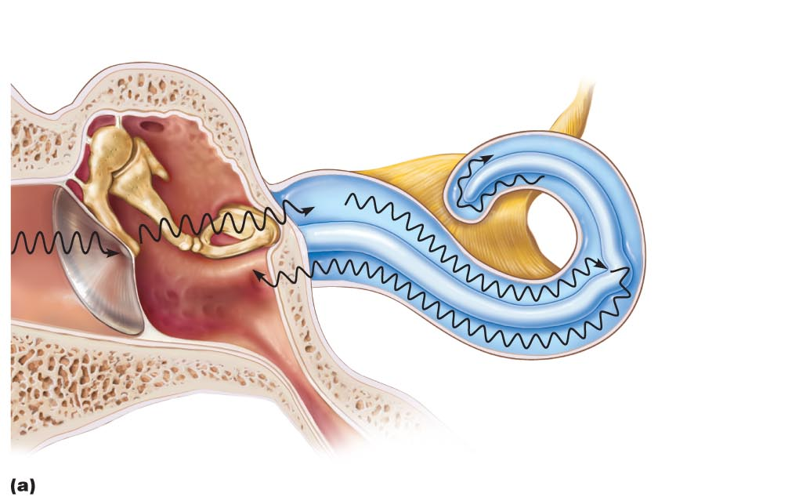
Figure 15.30a Pathway of sound waves and resonance of the basilar membrane.
Slide 1
Auditory ossicles
Malleus
Incus
Stapes
Cochlear nerve
Scala vestibuli
Oval
window
Helicotrema
4a
Scala tympani
Cochlear duct
2
3
Basilar
membrane
4b
1
4a
Sounds with frequencies below hearing travel through the
helicotrema and do not excite hair cells.
Tympanic
membrane
Round
window
Route of sound waves through the ear
1
2
3
4b
Sound waves vibrate the tympanic membrane.
Auditory ossicles vibrate. Pressure is amplified.
Pressure waves created by the stapes pushing on the oval window move through fluid in the scala vestibuli.
Sounds in the hearing range go through the cochlear duct, vibrating the basilar membrane and
deflecting hairs on inner hair cells.

Slide 11
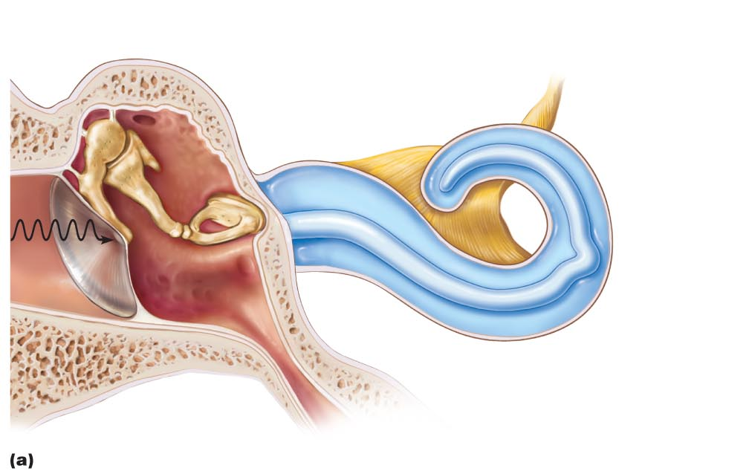
Figure 15.30a Pathway of sound waves and resonance of the basilar membrane.
Slide 2
Auditory ossicles
Malleus
Incus
Stapes
Cochlear nerve
Scala vestibuli
Oval
window
Helicotrema
Scala tympani
Cochlear duct
Basilar
membrane
1
Tympanic
membrane
Round
window
Route of sound waves through the ear
1
Sound waves vibrate the tympanic membrane.

Slide 12
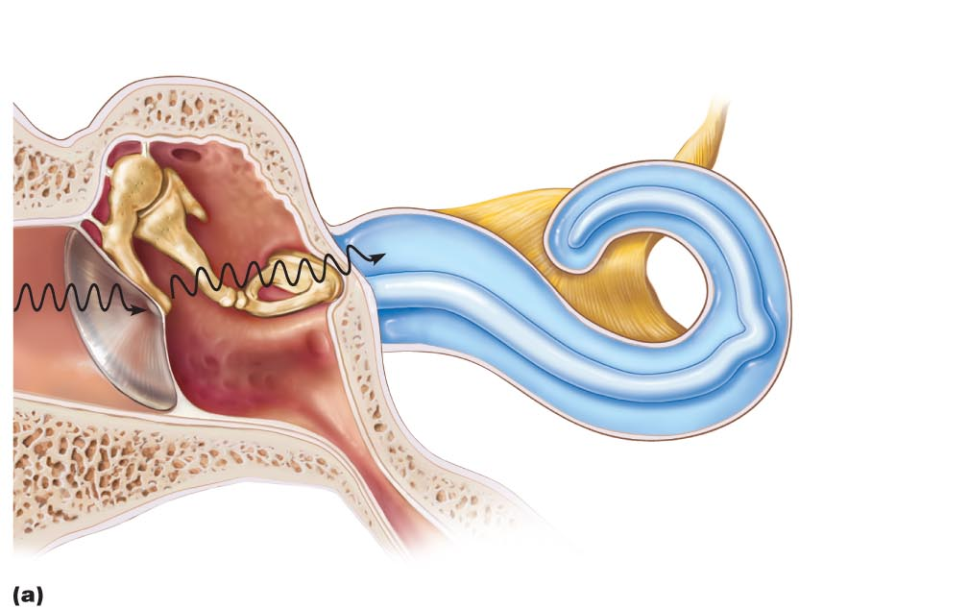
Figure 15.30a Pathway of sound waves and resonance of the basilar membrane.
Slide 3
Auditory ossicles
Malleus
Incus
Stapes
Cochlear nerve
Scala vestibuli
Oval
window
Helicotrema
Scala tympani
Cochlear duct
2
Basilar
membrane
1
Tympanic
membrane
Round
window
Route of sound waves through the ear
1
2
Sound waves vibrate the tympanic membrane.
Auditory ossicles vibrate. Pressure is amplified.

Slide 13
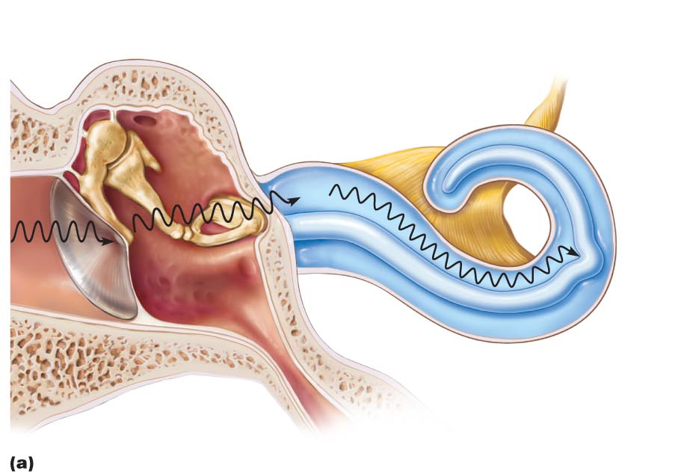
Figure 15.30a Pathway of sound waves and resonance of the basilar membrane.
Slide 4
Auditory ossicles
Malleus
Incus
Stapes
Cochlear nerve
Scala vestibuli
Oval
window
Helicotrema
Scala tympani
Cochlear duct
2
3
Basilar
membrane
1
Tympanic
membrane
Round
window
Route of sound waves through the ear
1
2
3
Sound waves vibrate the tympanic membrane.
Auditory ossicles vibrate. Pressure is amplified.
Pressure waves created by the stapes pushing on the oval window move through fluid in the scala vestibuli.

Slide 14
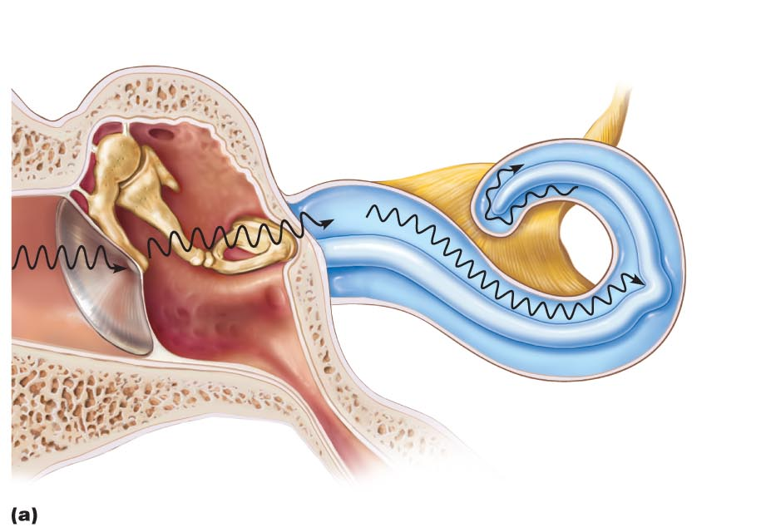
Figure 15.30a Pathway of sound waves and resonance of the basilar membrane.
Slide 5
Auditory ossicles
Malleus
Incus
Stapes
Cochlear nerve
Scala vestibuli
Oval
window
Helicotrema
4a
Scala tympani
Cochlear duct
2
3
Basilar
membrane
1
4a
Sounds with frequencies below hearing travel through the
helicotrema and do not excite hair cells.
Tympanic
membrane
Round
window
Route of sound waves through the ear
1
2
3
Sound waves vibrate the tympanic membrane.
Auditory ossicles vibrate. Pressure is amplified.
Pressure waves created by the stapes pushing on the oval window move through fluid in the scala vestibuli.

Slide 15
Figure 15.30a Pathway of sound waves and resonance of the basilar membrane.
Slide 6
Auditory ossicles
Malleus
Incus
Stapes
Cochlear nerve
Scala vestibuli
Oval
window
Helicotrema
4a
Scala tympani
Cochlear duct
2
3
Basilar
membrane
4b
1
4a
Sounds with frequencies below hearing travel through the
helicotrema and do not excite hair cells.
Tympanic
membrane
Round
window
Route of sound waves through the ear
1
2
3
4b
Sound waves vibrate the tympanic membrane.
Auditory ossicles vibrate. Pressure is amplified.
Pressure waves created by the stapes pushing on the oval window move through fluid in the scala vestibuli.
Sounds in the hearing range go through the cochlear duct, vibrating the basilar membrane and
deflecting hairs on inner hair cells.

Slide 16
Resonance of the Basilar Membrane
Fibers near oval window short and stiff
  Resonate with high-frequency pressure waves
Fibers near cochlear apex longer, more floppy
  Resonate with lower-frequency pressure waves
This mechanically processes sound before signals reach receptors

Slide 17
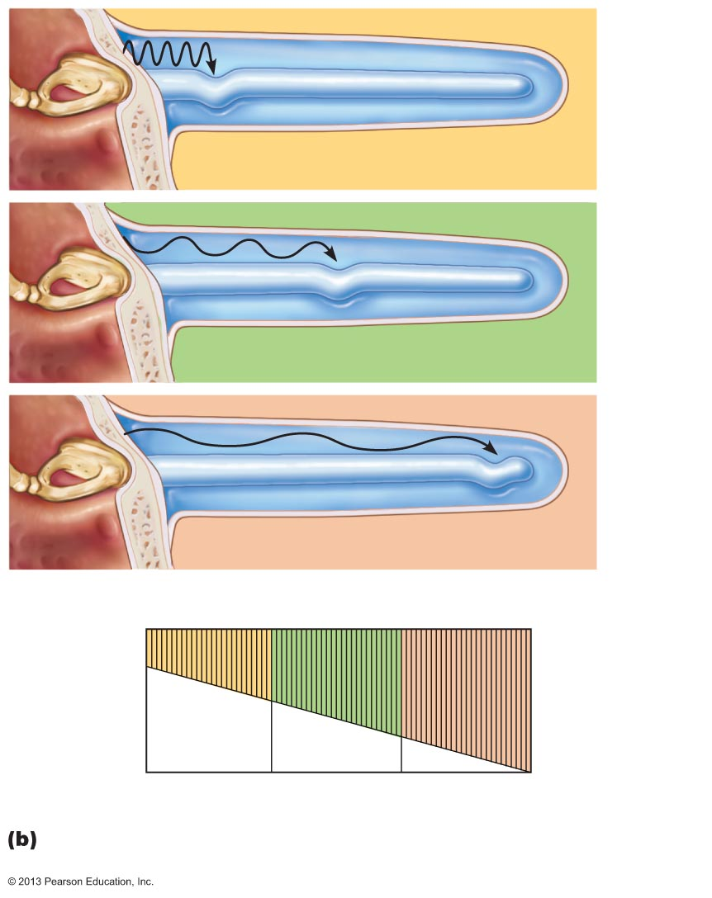
Figure 15.30b Pathway of sound waves and resonance of the basilar membrane.
Basilar membrane
High-frequency sounds displace the
basilar membrane near the base.
Medium-frequency sounds displace the
basilar membrane near the middle.
Low-frequency sounds displace the
basilar membrane near the apex.
Fibers of basilar membrane
Apex
(long,
floppy
fibers)
Base (short,
stiff fibers)
20,000
2000
200
20
Frequency (Hz)
Different sound frequencies cross the basilar membrane at different locations.

Slide 18
Excitation of Hair Cells in the Spiral Organ
Cells of spiral organ
  Supporting cells
  Cochlear hair cells
    One row of inner hair cells
    Three rows of outer hair cells
    Have many stereocilia and one kinocilium
Afferent fibers of cochlear nerve coil about bases of hair cells

Slide 19
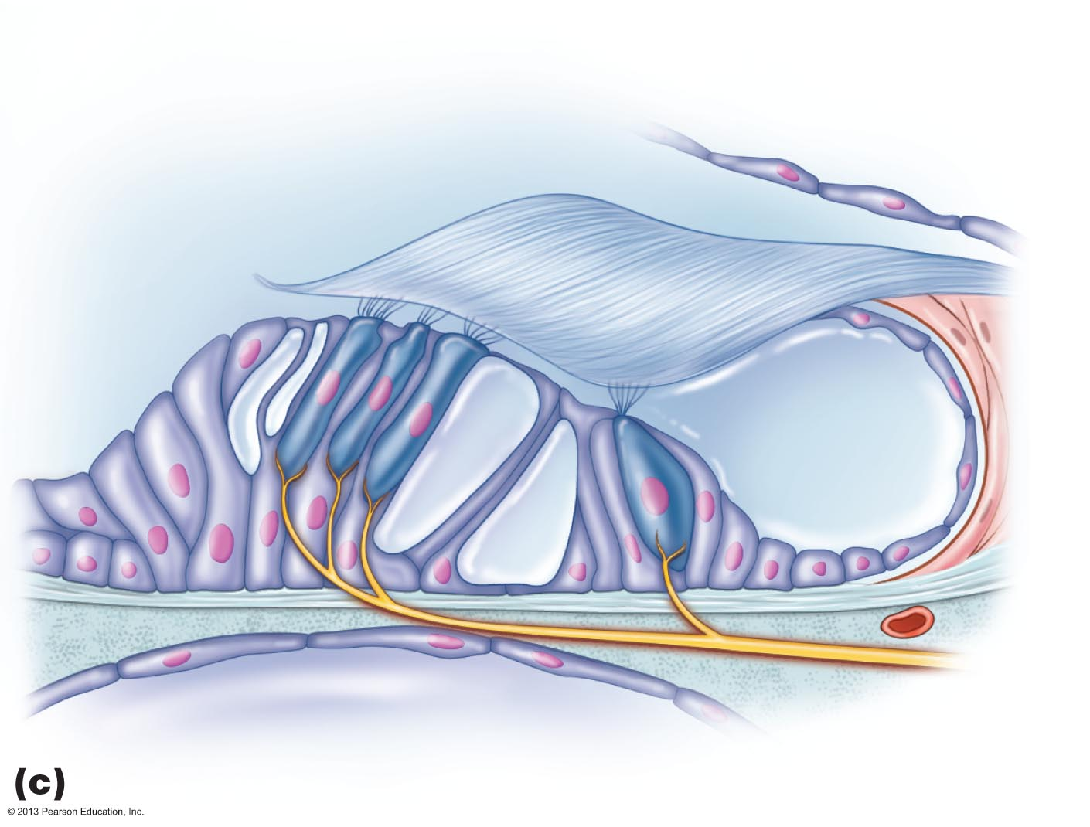
Figure 15.27c Anatomy of the cochlea.
Tectorial membrane
Inner hair cell
Hairs (stereocilia)
Afferent nerve
fibers
Outer hair cells
Supporting cells
Fibers of
cochlear
nerve
Basilar
membrane

Slide 20
Excitation of Hair Cells in the Spiral Organ
Stereocilia
  Protrude into endolymph
  Longest enmeshed in gel-like tectorial membrane
    Sound bending these toward kinocilium
      Opens mechanically gated ion channels
      Inward K⁺ and Ca²⁺ current causes graded potential and release of neurotransmitter glutamate
      Cochlear fibers transmit impulses to brain

Slide 21
Auditory Pathways to the Brain
Impulses from cochlea pass via spiral ganglion to cochlear nuclei of medulla
From there, impulses sent
  To superior olivary nucleus
  Via lateral lemniscus to Inferior colliculus (auditory reflex center)
From there, impulses pass to medial geniculate nucleus of thalamus, then to primary auditory cortex
Auditory pathways decussate so that both cortices receive input from both ears

Slide 22
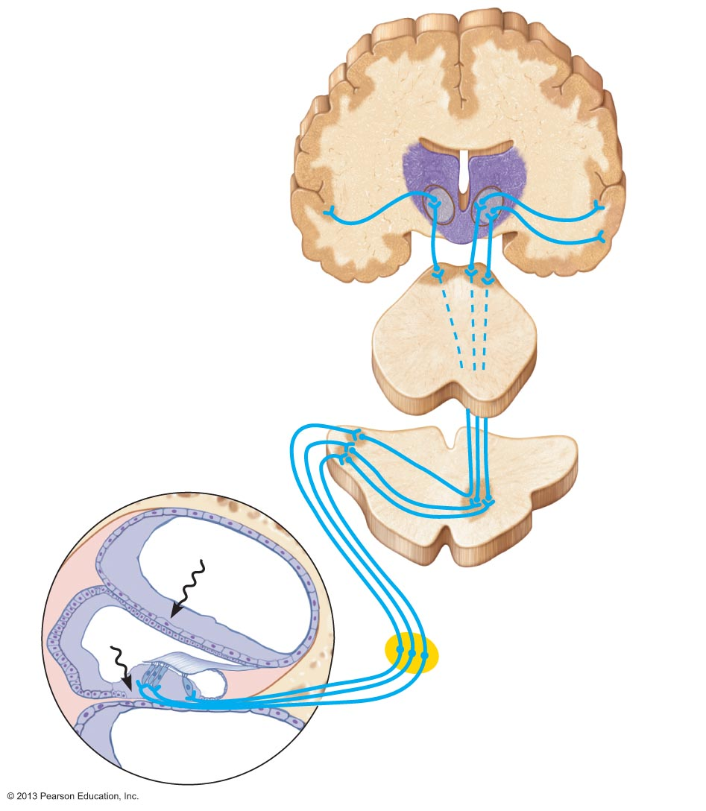
Figure 15.32 The auditory pathway.
Medial geniculate
nucleus of thalamus
Primary auditory
cortex in temporal lobe
Inferior colliculus
Lateral lemniscus
Superior olivary
nucleus (pons-
medulla junction)
Midbrain
Cochlear nuclei
Vibrations
Medulla
Vestibulocochlear
nerve
Vibrations
Spiral ganglion
of cochlear nerve
Bipolar cell
Spiral organ

Slide 23
Auditory Processing
Pitch perceived by impulses from specific hair cells in different positions along basilar membrane
Loudness detected by increased numbers of action potentials that result when hair cells experience larger deflections
Localization of sound depends on relative intensity and relative timing of sound waves reaching both ears

Slide 24
Equilibrium and Orientation
Vestibular apparatus
  Equilibrium receptors in semicircular canals and vestibule
  Vestibular receptors monitor static equilibrium
  Semicircular canal receptors monitor dynamic equilibrium

Slide 25
Maculae
Sensory receptors for static equilibrium
One in each saccule wall and one in each utricle wall
Monitor the position of head in space, necessary for control of posture
Respond to linear acceleration forces, but not rotation
Contain supporting cells and hair cells
Stereocilia and kinocilia are embedded in the otolith membrane studded with otoliths (tiny CaCO₃ stones)

Slide 26
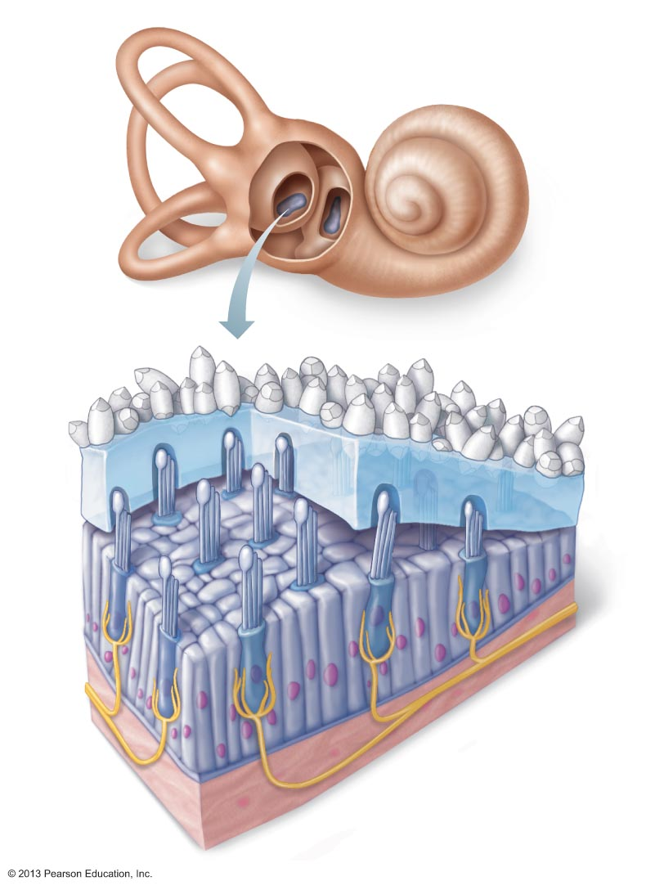
Figure 15.33 Structure of a macula.
Macula of
utricle
Macula of
saccule
Kinocilium
Otolith
membrane
Stereocilia
Otoliths
Hair bundle
Hair cells
Supporting
cells
Vestibular
nerve fibers

Slide 27
Maculae
Maculae in utricle respond to horizontal movements and tilting head side to side
Maculae in saccule respond to vertical movements
Hair cells synapse with vestibular nerve fibers

Slide 28
Activating Maculae Receptors
Hair cells release neurotransmitter continuously
  Movement modifies amount they release
Bending of hairs in direction of kinocilia
  Depolarizes hair cells
  Increases amount of neurotransmitter release
  More impulses travel up vestibular nerve to brain

Slide 29
Activating Maculae Receptors
Bending away from kinocilium
  Hyperpolarizes receptors
  Less neurotransmitter released
  Reduces rate of impulse generation
Thus brain informed of changing position of head

Slide 30
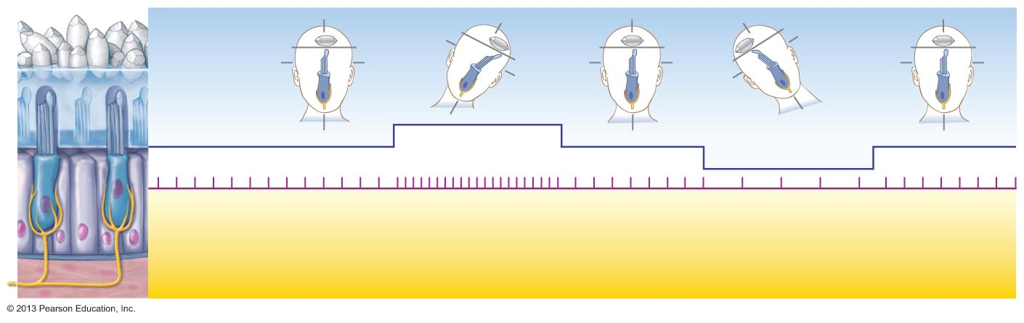
Figure 15.34 The effect of gravitational pull on a macula receptor cell in the utricle.
Otolith
membrane
Kinocilium
Stereocilia
Receptor potential
Depolarization
Hyperpolarization
Nerve impulses generated
in vestibular fiber
When hairs bend toward
the kinocilium, the hair cell
depolarizes, exciting the
nerve fiber, which generates
more frequent action potentials.
When hairs bend away
from the kinocilium, the hair cell
hyperpolarizes, inhibiting the nerve
fiber, and decreasing the action
potential frequency.

Slide 31
The Crista Ampullares (Crista)
Sensory receptor for rotational acceleration
  One in ampulla of each semicircular canal
  Major stimuli are rotational movements
Each crista has supporting cells and hair cells that extend into gel-like mass called ampullary cupula
Dendrites of vestibular nerve fibers encircle base of hair cells

Slide 32
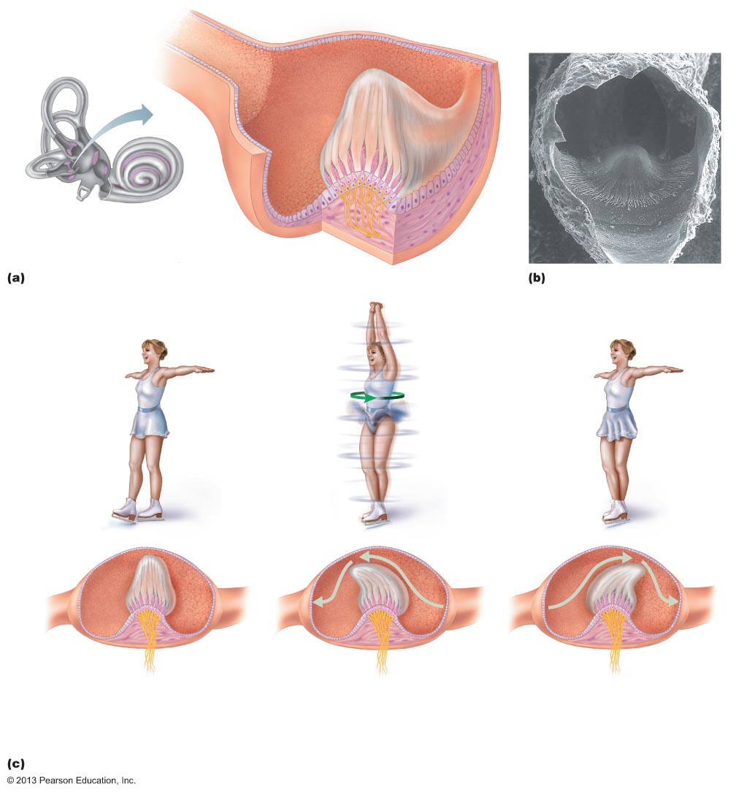
Figure 15.35a–b Location, structure, and function of a crista ampullaris in the internal ear.
Ampullary cupula
Crista
ampullaris
Endolymph
Hair bundle
(kinocilium
plus stereocilia)
Crista
ampullaris
Hair cell
Membranous
labyrinth
Fibers of vestibular nerve
Supporting
cell
Anatomy of a crista ampullaris in a semicircular canal
Scanning electron micrograph
of a crista ampullaris (200x)
Section of
ampulla,
filled with
endolymph
Cupula
Fibers of
vestibular
nerve
Flow of endolymph
At rest, the cupula stands upright.
During rotational acceleration, endolymph moves inside the semicircular canals in the direction opposite the rotation (it lags behind due to inertia). Endolymph flow bends the cupula and excites the hair cells.
As rotational movement slows, endolymph keeps moving in the direction of rotation. Endolymph flow bends the cupula in the opposite direction from acceleration and inhibits the hair cells.
Movement of the ampullary cupula during rotational acceleration and deceleration

Slide 33
Activating Crista Ampullaris Receptors
Cristae respond to changes in velocity of rotational movements of the head
Bending of hairs in cristae causes
  Depolarizations, and rapid impulses reach brain at faster rate

Slide 34
Activating Crista Ampullaris Receptors
Bending of hairs in the opposite direction causes
  Hyperpolarizations, and fewer impulses reach the brain
Thus brain informed of rotational movements of head

Slide 35
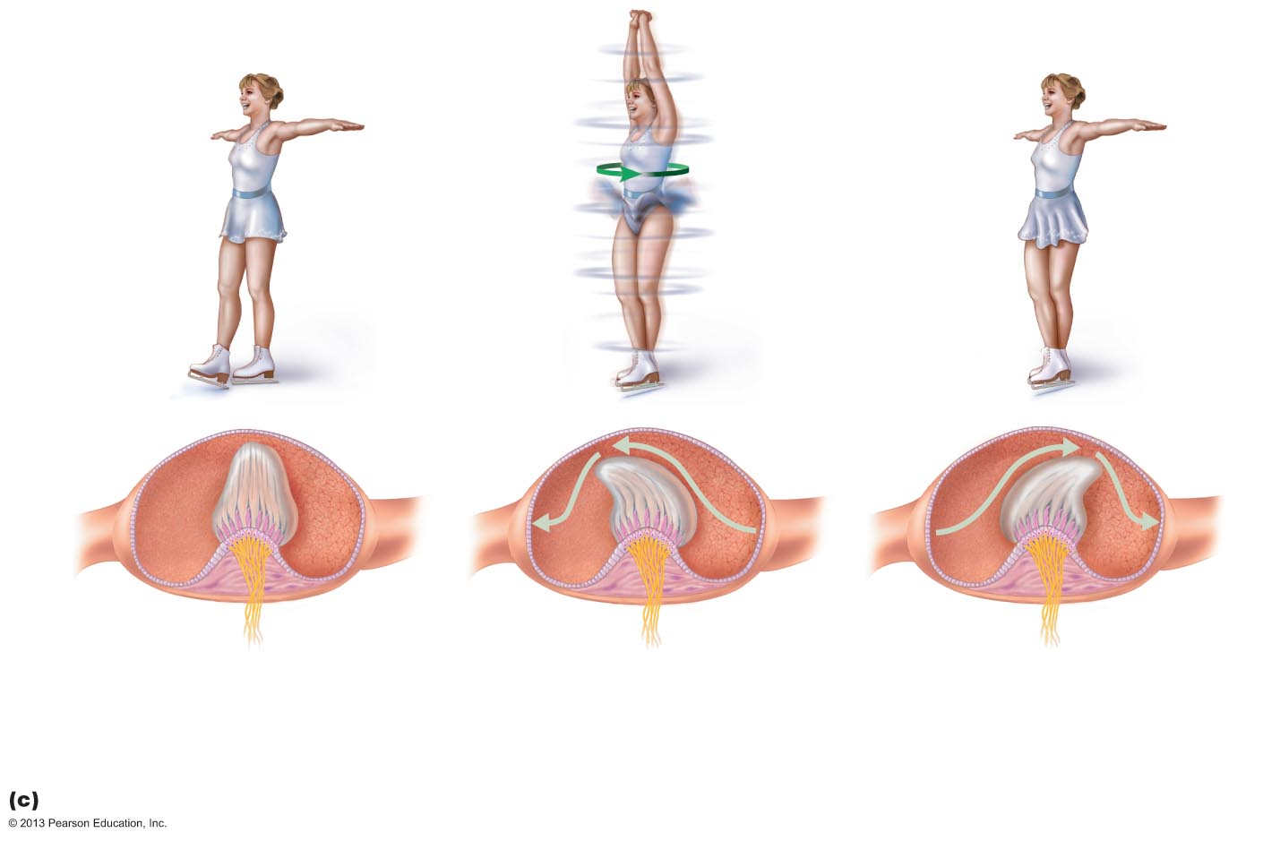
Figure 15.35c Location, structure, and function of a crista ampullaris in the internal ear.
Section of
ampulla,
filled with
endolymph
Cupula
Fibers of
vestibular
nerve
Flow of endolymph
At rest, the cupula stands upright.
During rotational acceleration, endolymph moves inside the semicircular canals in the direction opposite the rotation (it lags behind due to inertia). Endolymph flow bends the cupula and excites the hair cells.
As rotational movement slows, endolymph keeps moving in the direction of rotation. Endolymph flow bends the cupula in the opposite direction from acceleration and inhibits the hair cells.
Movement of the ampullary cupula during rotational acceleration and deceleration

Slide 36
Vestibular Nystagmus
Strange eye movements during and immediately after rotation
  Often accompanied by vertigo
As rotation begins eyes drift in direction opposite to rotation, then CNS compensation causes rapid jump toward direction of rotation
As rotation ends eyes continue in direction of spin then jerk rapidly in opposite direction

Slide 37
Equilibrium Pathway to the Brain
Equilibrium information goes to reflex centers in brain stem
  Allows fast, reflexive responses to imbalance
Impulses travel to vestibular nuclei in brain stem or cerebellum, both of which receive other input
Three modes of input for balance and orientation:
  Vestibular receptors
  Visual receptors
  Somatic receptors

Slide 38
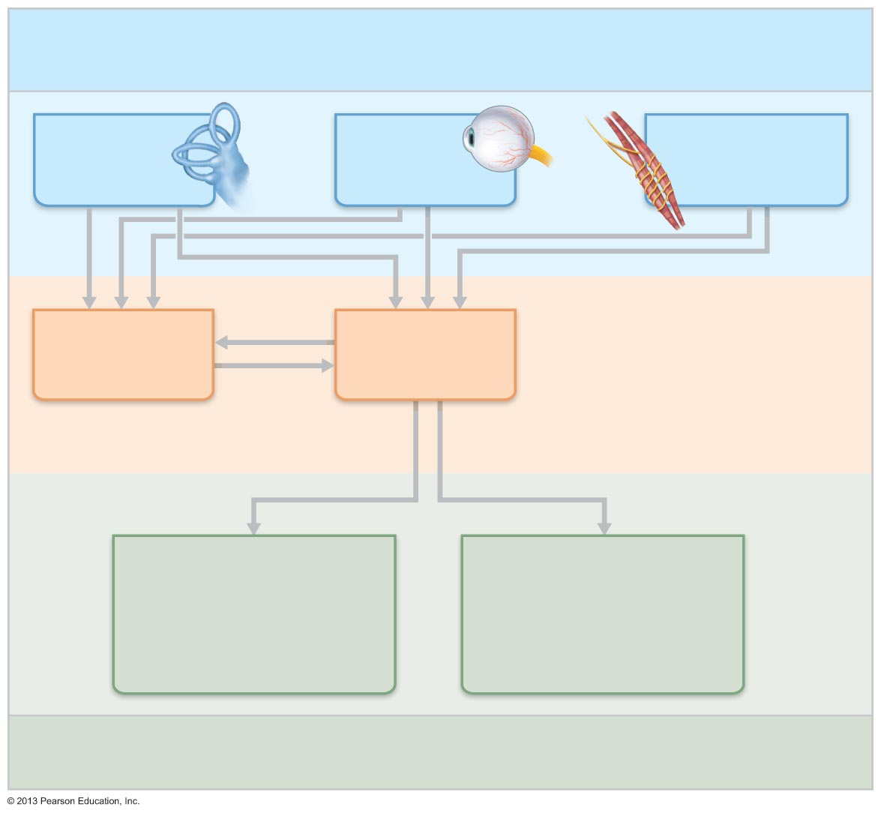
Figure 15.36 Neural pathways of the balance and orientation system.
Input: Information about the body’s position in space comes from
three main sources and is fed into two major processing areas in the
central nervous system.
Vestibular
receptors
Visual
receptors
Somatic receptors
(skin, muscle
and joints)
Vestibular
nuclei
(brain stem)
Cerebellum
Central nervous
system processing
Oculomotor control
(cranial nerve nuclei
III, IV, VI)
(eye movements)
Spinal motor control
(cranial nerve XI nuclei
and vestibulospinal tracts)
(neck, limb, and trunk
movements)
Output: Responses by the central nervous system provide fast
reflexive control of the muscles serving the eyes, neck, limbs, and
trunk.

Slide 39
Motion Sickness
Sensory input mismatches
  Visual input differs from equilibrium input
  Conflicting information causes motion sickness
Warning signs are excess salivation, pallor, rapid deep breathing, profuse sweating
Treatment with antimotion drugs that depress vestibular input such as meclizine and scopolamine

Slide 40
Homeostatic Imbalances of Hearing
Conduction deafness
  Blocked sound conduction to fluids of internal ear
    Impacted earwax, perforated eardrum, otitis media, otosclerosis of the ossicles
Sensorineural deafness
  Damage to neural structures at any point from cochlear hair cells to auditory cortical cells
  Typically from gradual hair cell loss

Slide 41
Treating Deafness
Research trying to prod supporting cell differentiation into hair cells to treat sensorineural deafness
Cochlear implants for congenital or age/noise cochlear damage
  Convert sound energy into electrical signals
  Inserted into drilled recess in temporal bone
  So effective that deaf children can learn to speak

Slide 42
Homeostatic Imbalances of Hearing
Tinnitus
  Ringing or clicking sound in ears in absence of auditory stimuli
  Due to cochlear nerve degeneration, inflammation of middle or internal ears, side effects of aspirin
Ménière's syndrome: labyrinth disorder that affects cochlea and semicircular canals
  Causes vertigo, nausea, and vomiting

Slide 43
Developmental Aspects
All special senses are functional at birth
Chemical senses—few problems occur until fourth decade, when these senses begin to decline
  Odor and taste detection poor after 65
Vision—optic vesicles protrude from diencephalon during fourth week of development
  Vesicles indent to form optic cups; their stalks form optic nerves
  Later, lens forms from ectoderm

Slide 44
Developmental Aspects
Vision not fully functional at birth
Babies hyperopic, see only gray tones, eye movements uncoordinated, tearless for 2 weeks
Depth perception, color vision well developed by age three; emmetropic eyes developed by year six
With age, lens loses clarity, dilator muscles less efficient, visual acuity drastically decreased by age 70 and lacrimal glands less active so eyes dry, more prone to infection

Slide 45
Developmental Aspects
Ear development begins in three-week embryo
Inner ears develop from otic placodes, which invaginate into otic pit and otic vesicle
Otic vesicle becomes membranous labyrinth, and surrounding mesenchyme becomes bony labyrinth
Middle ear structures develop from pharyngeal pouches
Branchial groove develops into outer ear structures

Slide 46
Developmental Aspects
Newborns can hear but early responses reflexive
Language skills tied to ability to hear well
Congenital abnormalities common
  Missing pinnae, closed or absent external acoustic meatuses
  Maternal rubella causes sensorineural deafness

Slide 47
Developmental Aspects
Few ear problems until 60s when deterioration of spiral organ noticeable
Hair cell numbers decline with age
  Presbycusis occurs first
    Loss of high pitch perception
    Type of sensorineural deafness

